Slide 1

APEX INSTITUTE OF TECHNOLOGY
DEPARTMENT OF COMPUTER SCIENCE & ENGINEERING
Database Management System (22CSH-243)
Faculty: Ms.Shaveta Jain (E13464)
Lecture - 6
Integrity Constraints
DISCOVER . LEARN . EMPOWER

Slide 2
DBMS: Course Objectives
COURSE OBJECTIVES
The Course aims to:
Understand database system concepts and design databases for different applications and to acquire the knowledge on DBMS and RDBMS.
Implement and understand different types of DDL, DML and DCL statements.
Understand transaction concepts related to databases and recovery/backup techniques required for the proper storage of data.

Slide 3
COURSE OUTCOMES
On completion of this course, the students shall be able to:-
CO1 | Understand the database concept, system architecture and role of database administrator

Slide 4
Attribute Types
The set of allowed values for each attribute is called the domain of the attribute
Attribute values are (normally) required to be atomic; that is, indivisible
The special value null is a member of every domain. Indicated that the value is “unknown”
The null value causes complications in the definition of many operations

Slide 5
Integrity Constraints
Integrity constraints are a set of rules. It is used to maintain the quality of information.
Integrity constraints ensure that the data insertion, updating, and other processes have to be performed in such a way that data integrity is not affected.
Thus, integrity constraint is used to guard against accidental damage to the database.

Slide 6
Integrity Constraints
Domain Constraints
Allowable values for an attribute.
Domain integrity means the definition of a valid set of values for an attribute. You define - data type, - length or size - is null value allowed - is the value unique or not for an attribute.
Entity Integrity
No primary key attribute may be null. All primary key fields MUST have data
Entity:- Any thing which has some attributes is called an entity. Like hospital, doctor, car etc

Slide 7
Kinds of Integrity Constraints
Tables Operations:- ADD, Delete, Append and Update.
Integrity Rules :-
PK must be unique.
Related fields should have the same field type.
Related tables should belong to the same DB.

Slide 8
Cont...
Integrity Conditions:-
Foreign Key values must be identical to PK values.
Records of primary tables shouldn’t be deleted if it is related to another table.
Primary key shouldn’t be changed if this record is related to another table.
Cascade update related fields :-
During updating the PK in the primary table the value of the FK should be updated automatically.
Cascade deletes related records :-
During delete a record from the primary table all related records in related tables should be deleted also.

Slide 9
Referential Integrity Constraint
The rule that states that any foreign key value (on the relation of the many side) MUST match a primary key value in the relation of the one side. (Or the foreign key can be null)
The rules are: 1. You can't delete a record from a primary table if matching records exist in a related table. 2. You can't change a primary key value in the primary table if that record has related records. 3. You can't enter a value in the foreign key field of the related table that doesn't exist in the primary key of the primary table. 4. However, you can enter a Null value in the foreign key, specifying that the records are unrelated.

Slide 10
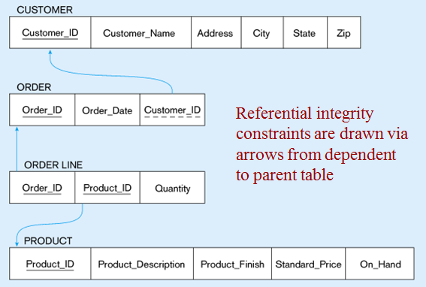
Cont...

Slide 11
Entity integrity rule
The entity integrity constraint states that primary keys can't be null. There must be a proper value in the primary key field. This is because the primary key value is used to identify individual rows in a table. If there were null values for primary keys, it would mean that we could not indentify those rows.
On the other hand, there can be null values other than primary key fields. Null value means that one doesn't know the value for that field. Null value is different from zero value or space.

Slide 12
Key Constraints
Values in a column (or columns) of a relation are unique: at most one row in a relation instance can contain a particular value(s)
Key - set of attributes satisfying key constraint
e.g., Id in Student,
e.g., (StudId, CrsCode, Semester) in Transcript
Super Key
Super Key is defined as a set of attributes within a table that uniquely identifies each record within a table. Super Key is a superset of Candidate key.
Candidate Key
Candidate keys are defined as the set of fields from which primary key can be selected. It is an attribute or set of attribute that can act as a primary key for a table to uniquely identify each record in that table.

Slide 13
Cont...
Primary Key
Primary key is a candidate key that is most appropriate to become main key of the table. It is a key that uniquely identify each record in a table. PK must be unique and Not Null.
Foreign Key
Foreign Key is a field or set of fields that are identical to a primary key in another table.

Slide 14
Cont...
Composite Key
Key that consist of two or more attributes that uniquely identify an entity occurance is called Composite key. But any attribute that makes up the Composite key is not a simple key in its own.
Secondary or Alternative key
The candidate key which are not selected for primary key are known as secondary keys or alternative keys
Non-key Attribute
Non-key attributes are attributes other than candidate key attributes in a table.
Non-prime Attribute
Non-prime Attributes are attributes other than Primary attribute.

Slide 15
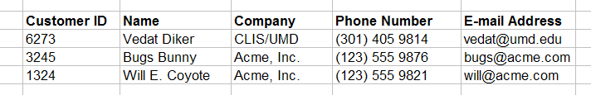
Cont...
Primary Key
Customers

Slide 16
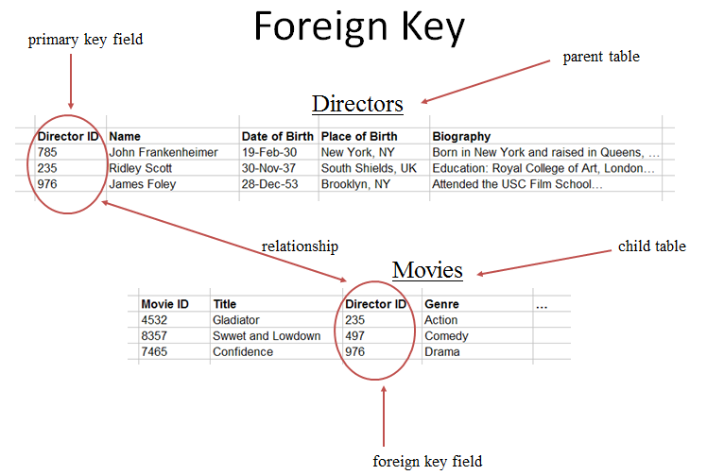
Cont...

Slide 17
Summary
Integrity constraints are a set of rules. It is used to maintain the quality of information.
Thus, integrity constraint is used to guard against accidental damage to the database.
There four types of integrity constraint discussed:
Domain- integrity constraint
Entity-integrity Constraint
Key constraint
Referential- integrity constraint.

Slide 18
FAQs
What are Entity integrity constraint
What is referential integrity constraint
What is super key?
What is alternate key?
How many primary keys can we have in a relation.

Slide 19
References
RamezElmasri and Shamkant B. Navathe, “Fundamentals of Database System”, The Benjamin / Cummings Publishing Co.
Korth and Silberschatz Abraham, “Database System Concepts”, McGraw Hall.
C.J.Date, “An Introduction to Database Systems”, Addison Wesley.
Thomas M. Connolly, Carolyn & E. Begg, “Database Systems: A Practical Approach to Design, Implementation and Management”, 5/E, University of Paisley, Addison-Wesley.

Slide 20
THANK YOU
For queries
Email: shaveta.e13464@cumail.in

